Slide 1
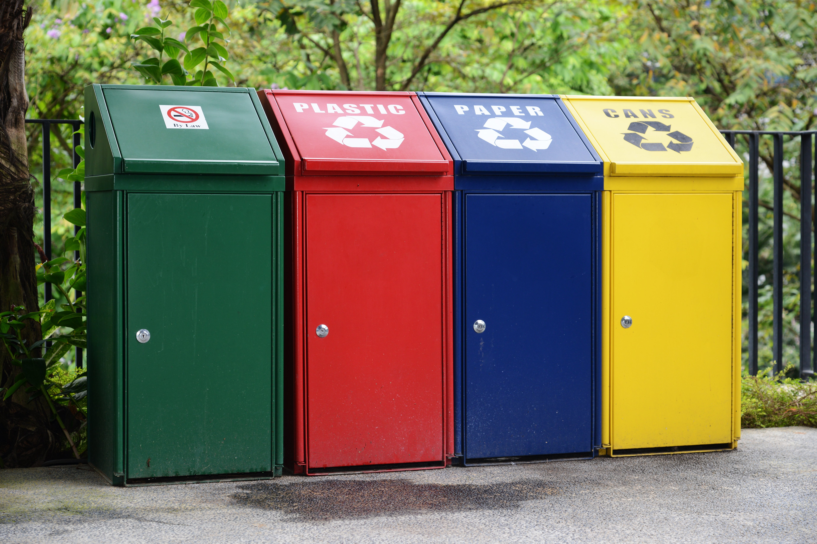

GAADI WALA (Waste Management Android App)
This Photo by Unknown author is licensed under CC BY-SA.

Slide 2
Need For Garbage Collection
The waste humans generate waste has been detrimental to our environment for quite some time now. Humans are generating too much trash and cannot deal with it in a sustainable way. Waste that is not biodegradable and cannot be properly be recycled is filling our oceans and landfills. Let’s take plastic waste as an example. A recent study found that of the 6.3 billion metric tons of plastic waste that has been produced, only 9% of that plastic waste had been recycled.

Slide 3
FEATURES OF A SMART WASTE MANAGEMENT APP
FEATURES OF OUR SMART WASTE MANAGEMENT APP
See all the bins on the map
Find nearest available bin
See how full is the bin
Discover the shortest route to the bin
User informs about the bin
Current location is visible
Garbage Collector can view the live location and nearest garbage collector comes for collection.
Users can raise complaints
Complaints are received to us and we do the needful

Slide 4


WORKING OF
GAADI WALA

Slide 5
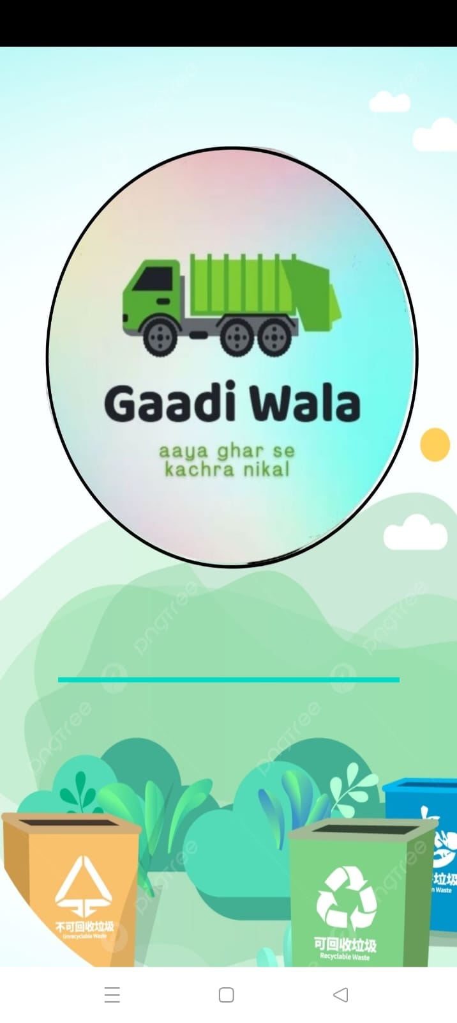

SPLASH SCREEN
Gaadi Wala is an android application created to meet the needs of the users and maintain the hygiene and provide the users with a quick cleanup of the requested bins thus acting as a smart way of cleanup.
The splash screen consists of the
LOGO and the name GAADI WALA is kept since it is user friendly and can be remembered.
The color scheme is green and all the pastel shades related with green so as to imply cleanliness and green environment

Slide 6
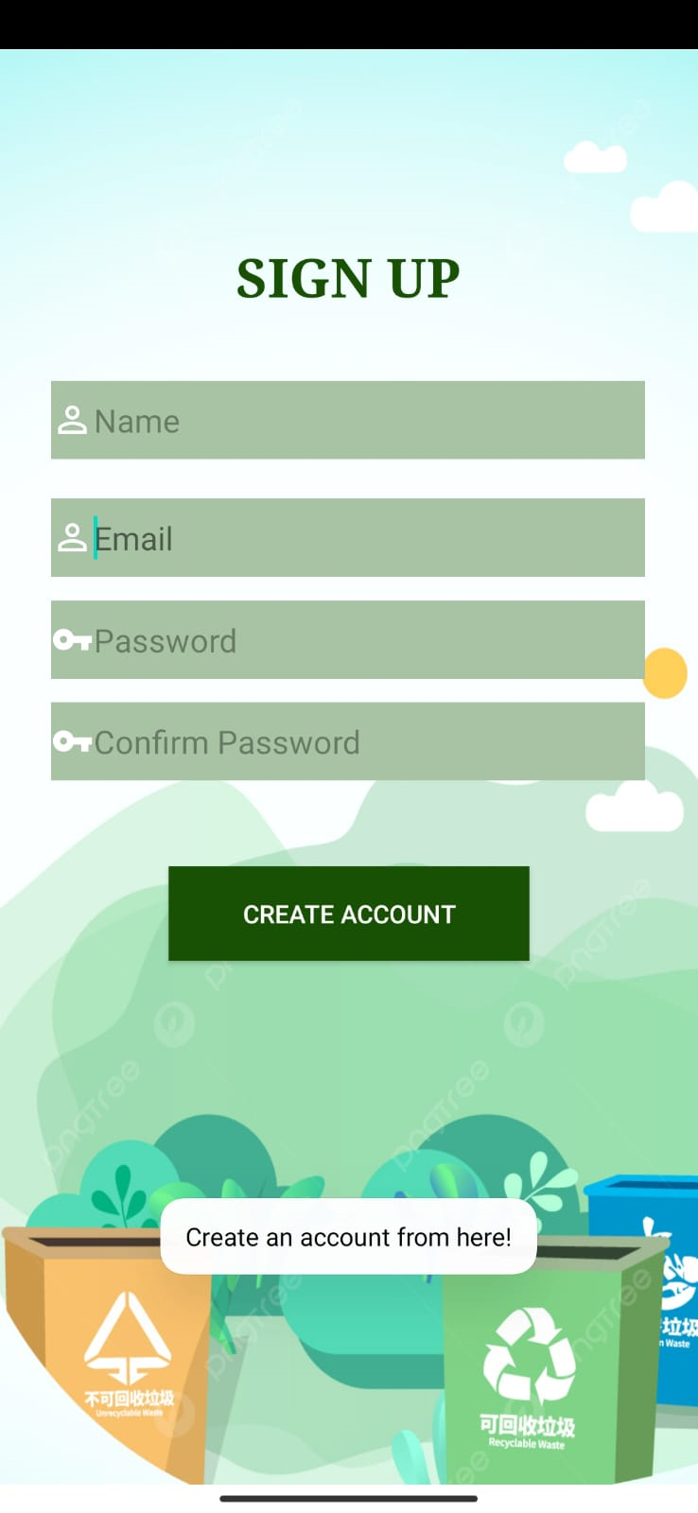
Sign Up page details
Landing page of the application (Sign Up page) is connected to firebase data given here is stored in firebase for user authention with username and password each and every field here is taken care of validation
Once after fillling details and clicked on create account a progress bar will be displayed and after the process is done user will be redirected to login page

Slide 7
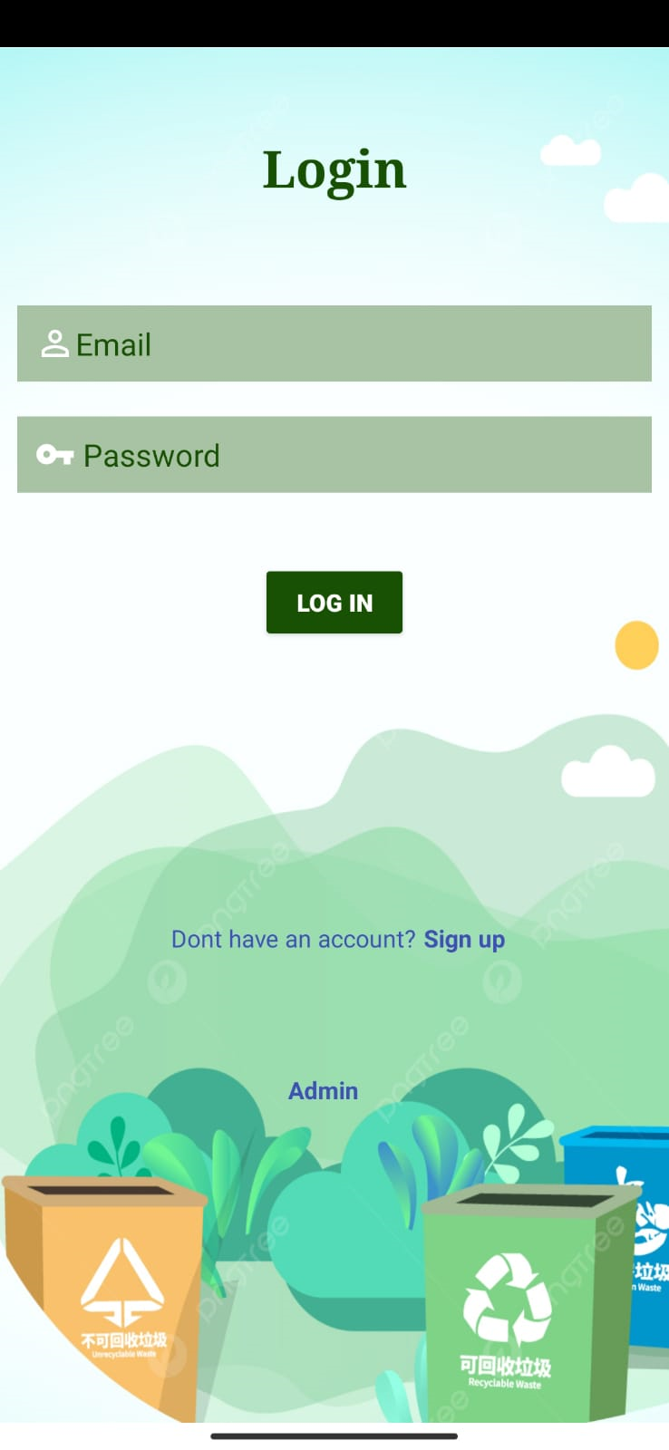
Login page details
Login page if user has already registered to the application he/she can directly login with the credentials
Below there are navigation links to signup and for admin login
After loggin in user will be re directed to Homepage
Home page will be shown untill user logs out if user closes and comes again to application homepage will be still disolayed without loggin in

Slide 8
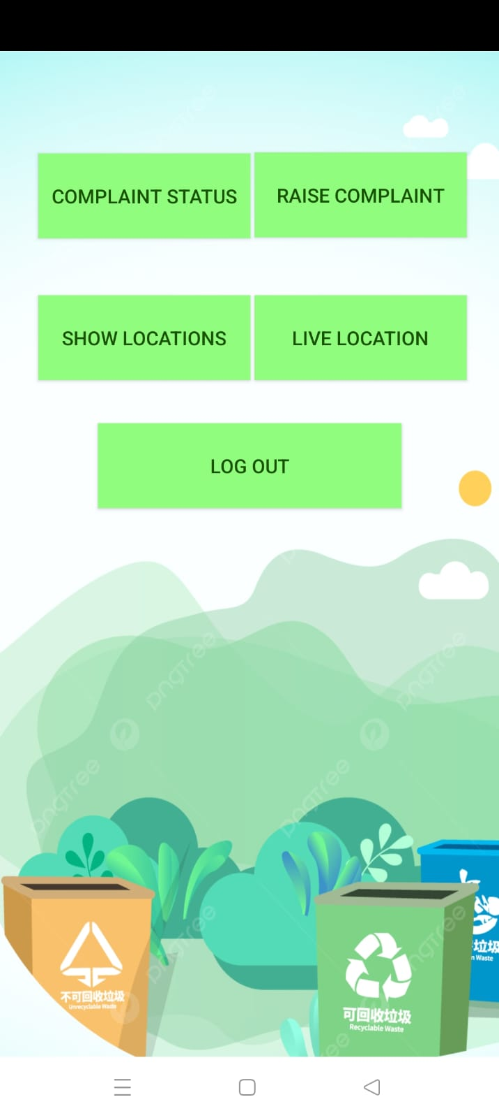

HOME SCREEN
Consists of 5 buttons each of which having functionalities.
COMPLAINT STATUS – To see the registered complaints
RAISE COMPLAINT – To raise the complaints
SHOW LOCATIONS – To view the surrounding the locations and state whether bin is full or not
LIVE LOCATION – To provide the live location
LOG OUT – To logout

Slide 9
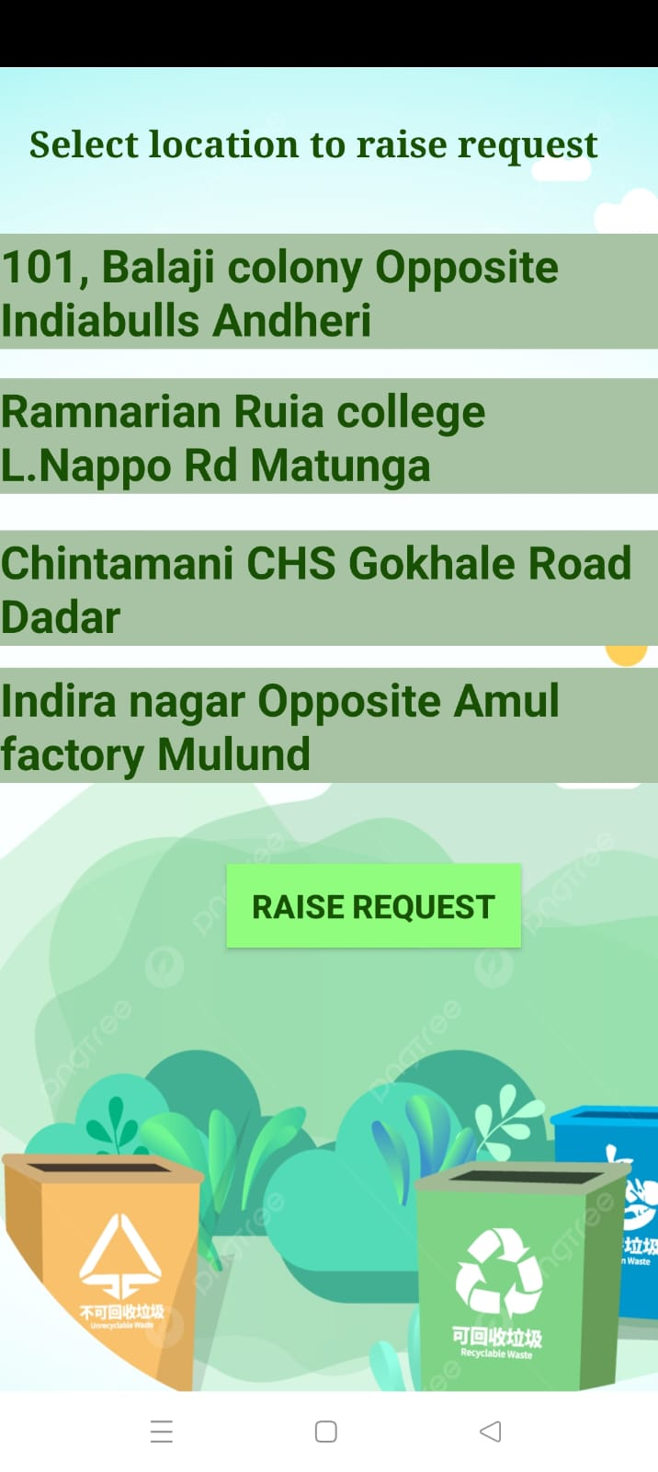

RAISE COMPLAINT
On clicking on RAISE COMPLAINT, users are navigated to this screen. As for now there are 4 locations based on which the users can raise complaints regarding the bins.
Users can select any of the locations and can click on RAISE REQUEST button to register their complaint.
User’s complaints can provide us with the information of areas that are needed be cleaned and thus our cleaning vehicles can reach that place and collect the garbage.

Slide 10
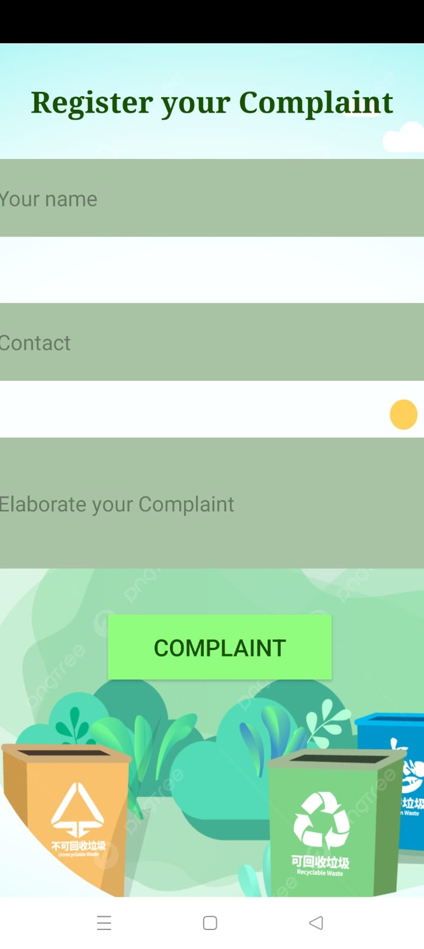
On clicking the RAISE REQUEST button, users are navigated to this screen.
It requires –
User’s name
User’s Contact
The elaboration of the complaint
And once it is done, click on the COMPLAINT button to successfully register the complaint.

Slide 11
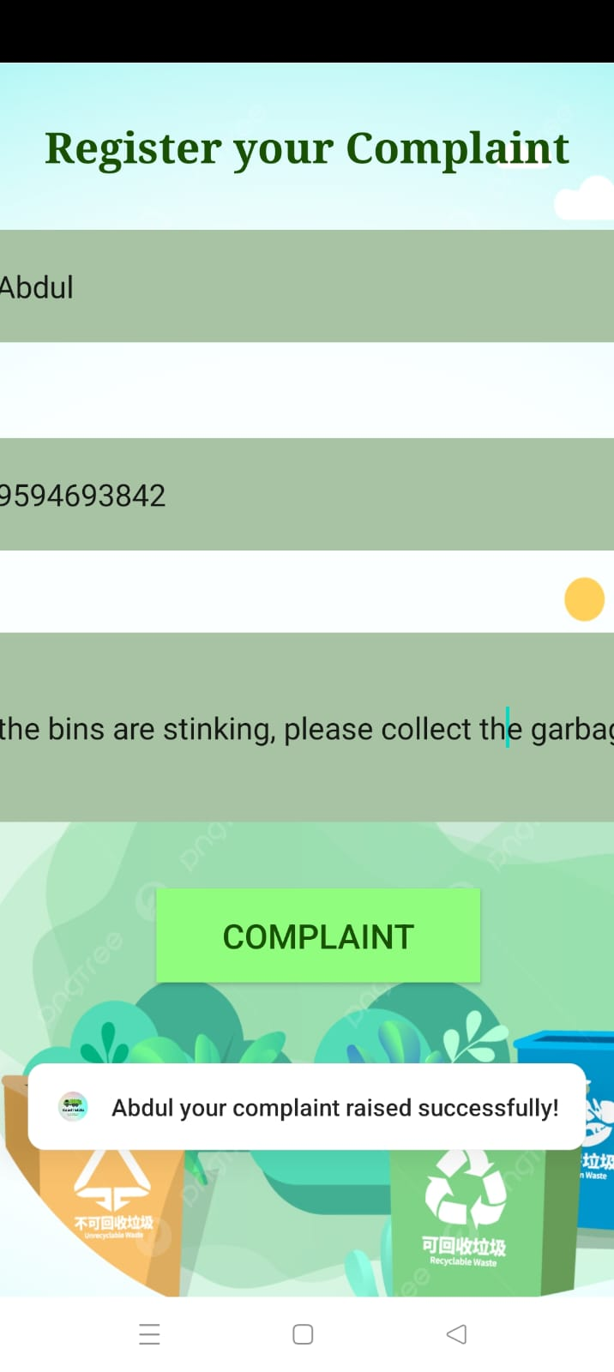

One can easily enter the required fields and thus the TOAST message is then visible on the screen along with the user’s name that is used to register the complaint.
It gave the prompt to user saying –
‘Name’ your complaint raised successfully!

Slide 12
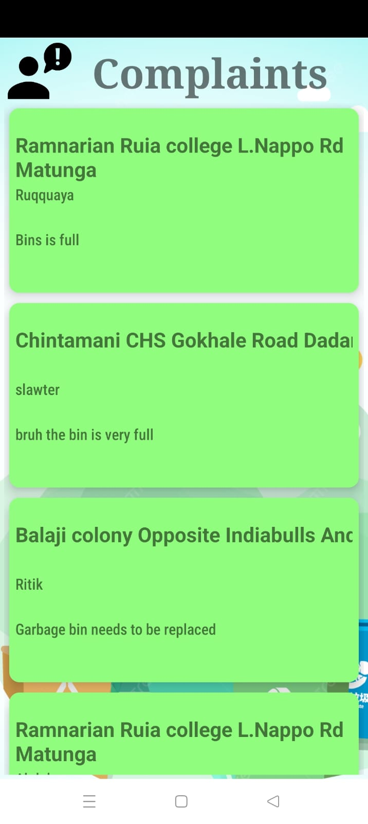
The registered complaints can be visible in the complaint status as shown and it is made publically which can be viewed by every users and it is reflected real time
Based on these requests, the garbage collecting vans can reach these specified locations and collect the garbage thus meeting the needs of the users.
Thus making this application user friendly, easy to use and help environment keep clean.

Slide 13
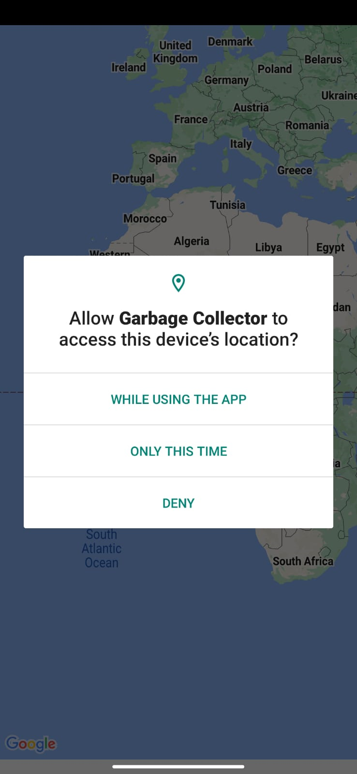
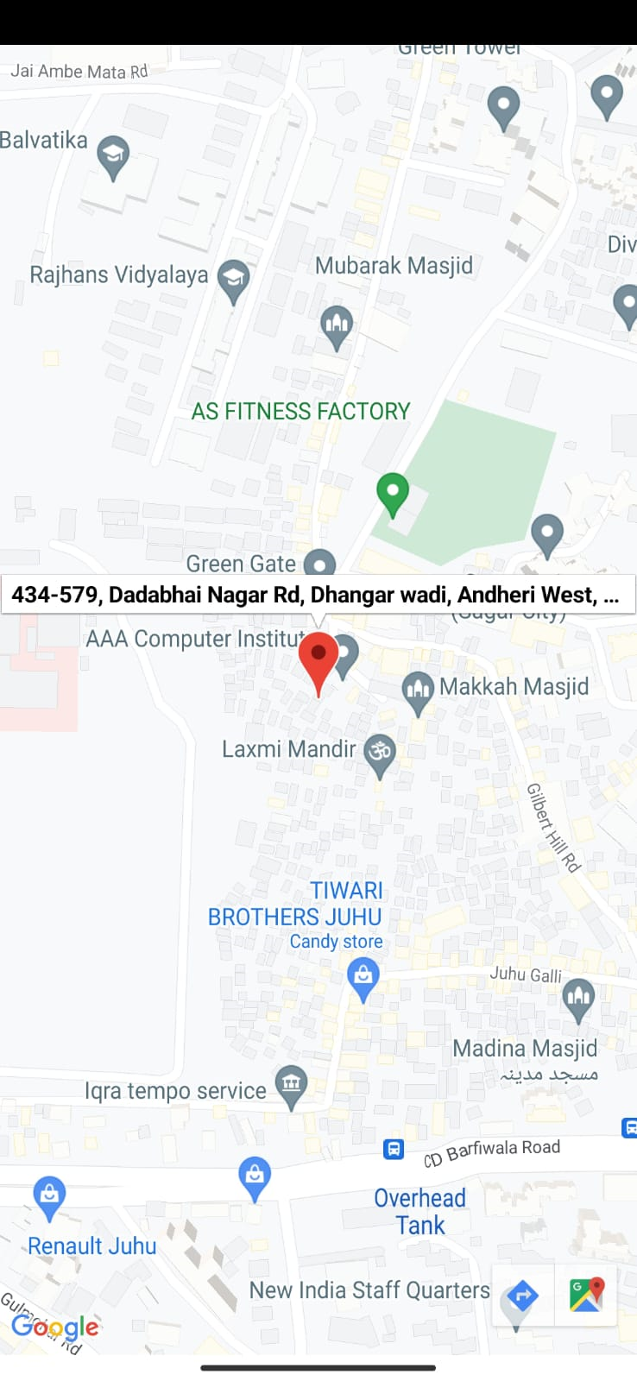

LIVE LOCATION
Live location page first asks the users for the accessing device’s location
If allowed – The maps starts and the pointer locates to your current location

Slide 14
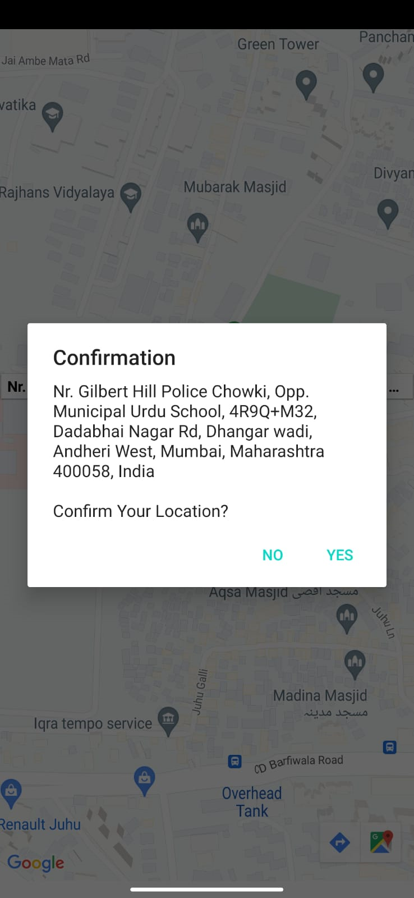
Confirming the location received
Alert Dailogue box will be appeared on
Clicking on location pointer confirms you location
Once clicked yes the location of the user will be sent to administrator

Slide 15
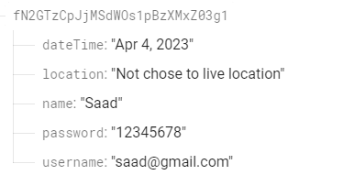
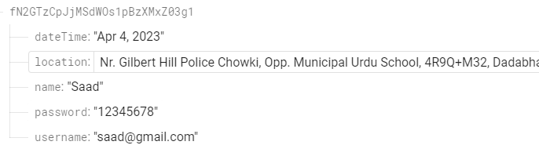
Before using live location
Afer live location is given

Slide 16
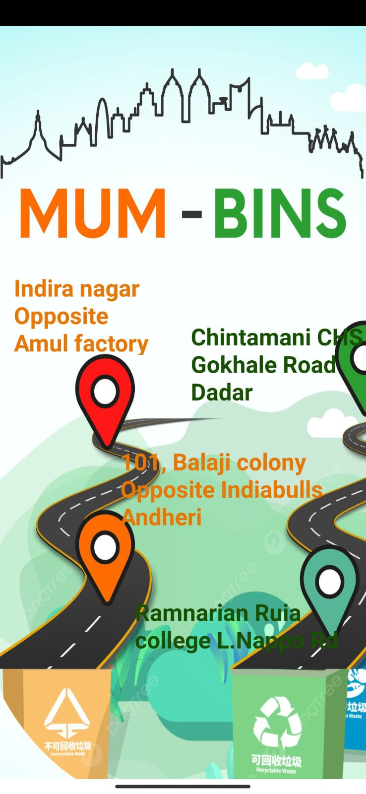
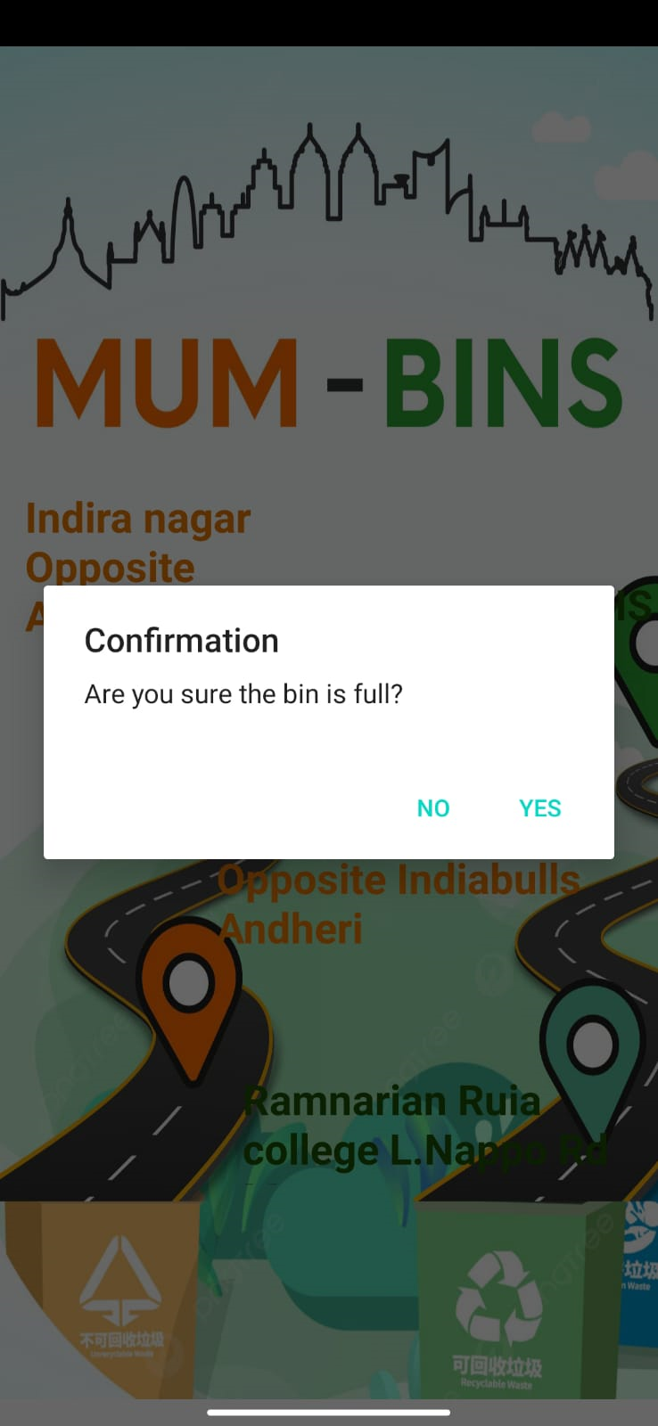
Major Garbage location in Mumbai
If any of the garbage bin is full you can click on that particular location and a screen like this will popup

Slide 17
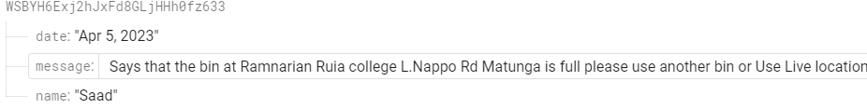
Update bin-data to admin and users
If clicked on Ramnarayan Ruia college Bin and
clicked yes it will be updated to the database
as this bin is full
We are working on to send this message as a notifcation to every registered customer

Slide 18




































































